Slide 1

Architecture Spike
Visualization
Project #3 Team Orange
Cady Pridgeon, Amee Kivette, Laura Wilson, Keanna Tennyson

Slide 2
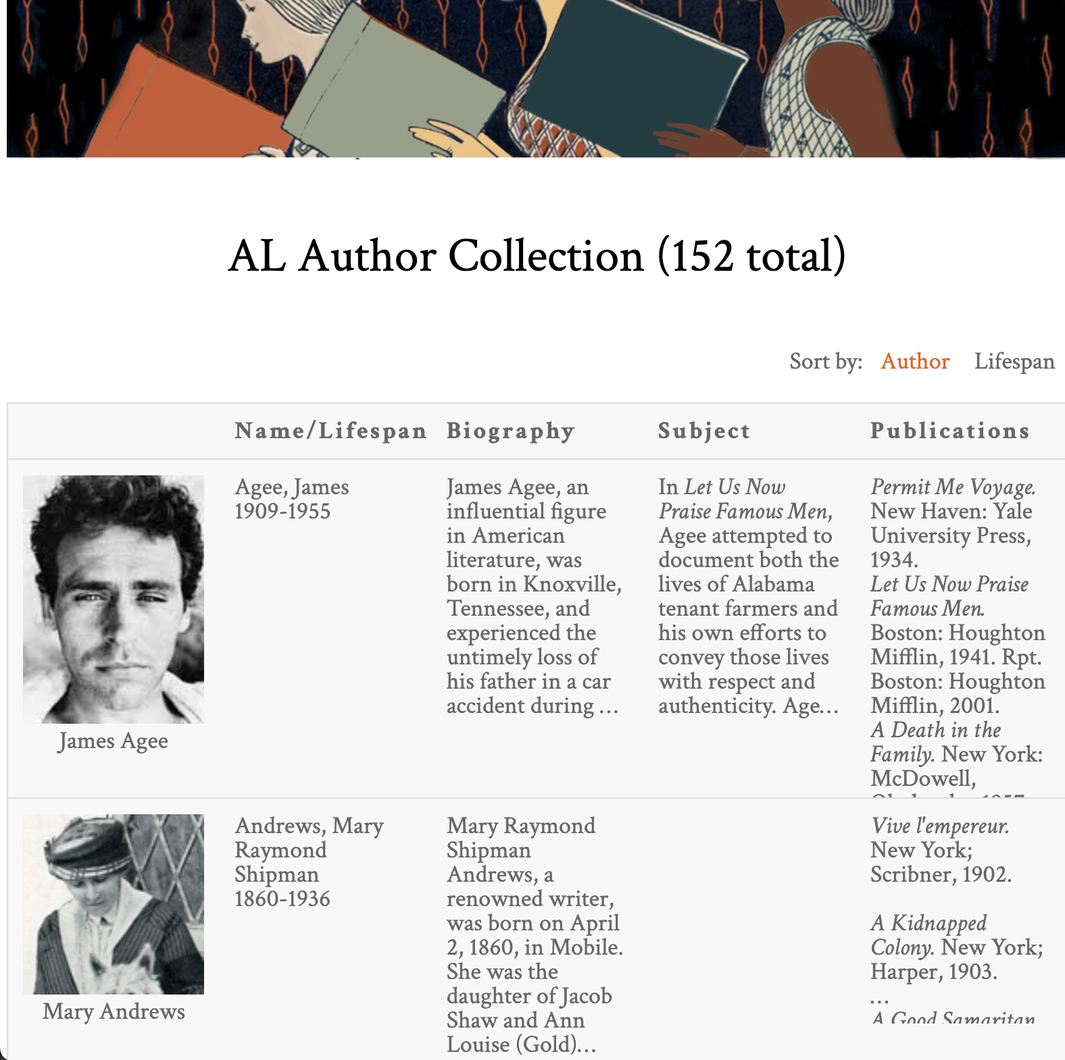
Alabama Authors
Laura Wilson
Introduction
Alabama Authors of the 19th and 20th Centuries
Dr. Beverly Park Rilett
Project Mission
Visualize wealth of data
Over 1500 authors
Chronology
Encourages data exploration
Valuable for research
Sample of the AL Author Collection from the Alabama Authors website

Slide 3
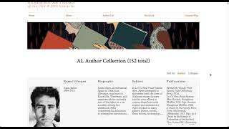
Current System Demo
Cady Pridgeon
Alabama Authors website

Slide 4

System Metaphor & Cycle Intent
Cady Pridgeon
System Metaphor
Museum exhibit
Allows visitors to take a glance before diving in
Cycle Intent
Establish project management
Gain project understanding
Increase amount of author data
Begin chronology data visualization
Person viewing work at an art gallery or exhibit

Slide 5
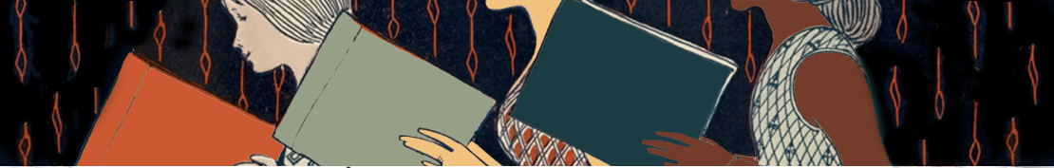
User Stories

Slide 6
1.0 Chronology Data Visualization
Cady Pridgeon
Summary
As a user, I want to view authors on the Alabama Authors website in a chronology/timeline format to better explore and learn about the authors.
Description
This type of visualization enables users to explore the periods authors were alive and popular in order to facilitate education, understanding, and research of the authors.
Status
Not Started

Slide 7
1.1 Chronology Data Visualization
Cady Pridgeon
Summary
As a user, I want to be able to see author names, birth years, death years, and image when I hover over or select nodes in order to quickly learn about the author without having to navigate to their details page.
Description
Allowing users to see important information at a glance on the visualization supports their exploration and search of authors. It also helps to differentiate nodes within the visualization.
Status
Not Started

Slide 8
1.2 Chronology Data Visualization
Cady Pridgeon
Summary
As a user, I want to be able to interact with author nodes on the visualization to access their details page, allowing me to quickly learn more about authors directly from the chronology.
Description
There are detailed pages for each author in the database, so it would support research and education about authors by permitting users to access these informative pages straight from a visualization.
Status
Not Started

Slide 9
1.3 Chronology Data Visualization
Cady Pridgeon
Summary
As a user, I want to be able to filter the visualization based on criteria, such as birth year or author name, in order to customize my exploration of relevant information.
Description
Including filtering functionality better equips users for efficient data exploration. Without it, users may feel frustrated or experience cognitive overload if they are unable to access information of interest quickly and effectively.
Status
Not Started

Slide 10
1.4 Chronology Data Visualization
Cady Pridgeon
Summary
As a user, I want to be able to export my visualization to keep for my records to conduct research or simply save my findings.
Description
Being able to quickly export a complex visualization into an image or PDF supports users in research and grants them a way to save progress after utilizing visualizations on the website.
Status
Not Started

Slide 11
1.5 Chronology Data Visualization
Cady Pridgeon
Summary
As a user, I want to view all of the Alabama authors from the 19th and 20th century to gain a complete picture of the literary landscape from this area and time.
Description
Currently, the website includes 150 authors in its literary map visualization and detail pages. However, there are around 1,500 data entries for authors from this time, so it is important to include these additional data points for completeness.
Status
In Progress

Slide 12
1.6 Chronology Data Visualization
Cady Pridgeon
Summary
As a user, I want to be able to access the Alabama Authors website from any device, such as a computer, tablet, or phone, and experience an accessible data visualization.
Description
The data visualization should be responsive, supporting users from any device, including a mobile phone.
Status
Not Started

Slide 13
1.7 Chronology Data Visualization
Cady Pridgeon
Summary
As a user, I want to experience an accessible user interface on the Alabama Authors website to ensure my abilities do not interfere with viable interactions on the website.
Description
Color contrast, tab index, and verbiage are a few aspects that make an interface accessible and inclusive. It is crucial that anyone, regardless of their abilities, should be able to access and navigate the website and visualizations with ease.
Status
Not Started

Slide 14
1.8 Chronology Data Visualization
Cady Pridgeon
Summary
As an administrator, I want to be able to manage the chronology/timeline data visualization with Omeka Classic to avoid issues with GitHub repository connections.
Description
Sometimes data visualizations are connected to the digital humanities websites by hosting the visualization on a GitHub repository and displaying the result on the website with an iframe. To prevent frustrations associated with this, we must create our visualization using plugins supported by Omeka Classic.
Status
In Progress

Slide 15
2.0 Author Details Page
Cady Pridgeon
Summary
As a user, I want to view an author's date of birth and date of death on their details page to quickly remember the period they lived through.
Description
While users can view an author's date of birth on data visualizations, their birth date and death date are missing from their detail page. This could frustrate users by creating an inconsistency in data availability over various pages on the site.
Status
Not Started

Slide 16
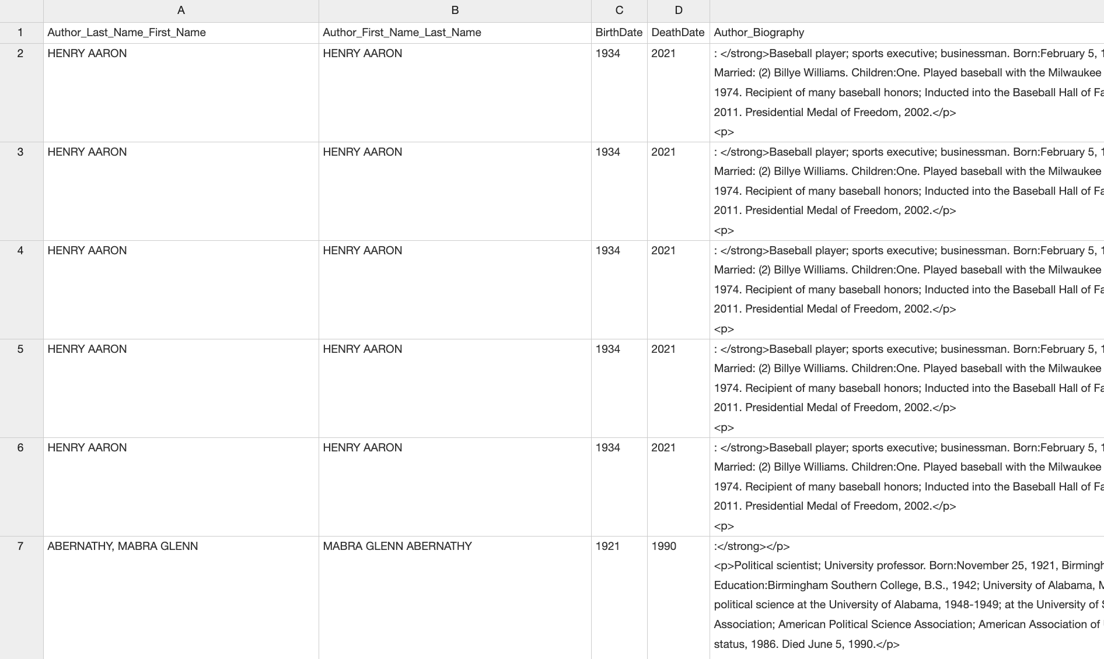
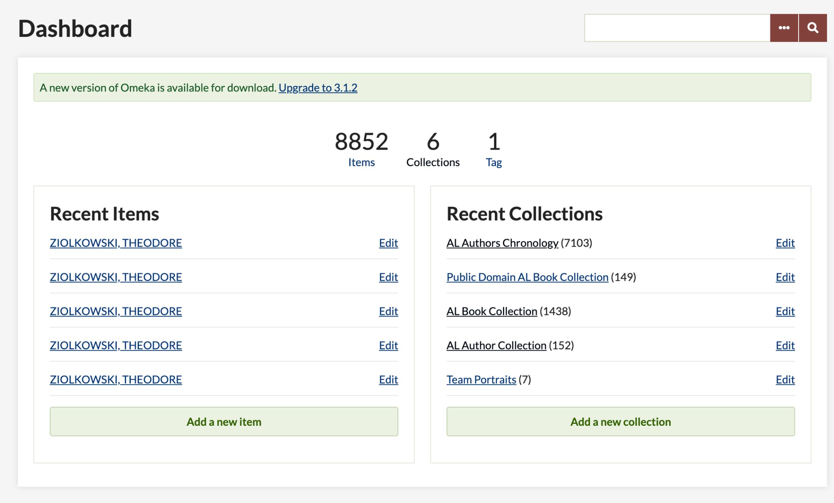
User Story 1.5 Progress
Cady Pridgeon
Alabama Authors data entries
Alabama Authors data in Omeka Classic

Slide 17
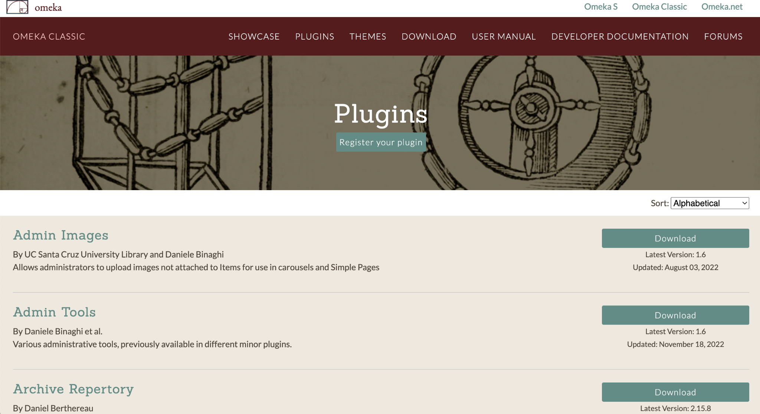
User Story 1.8 Progress
Cady Pridgeon
Omeka Classic plugin repository

Slide 18
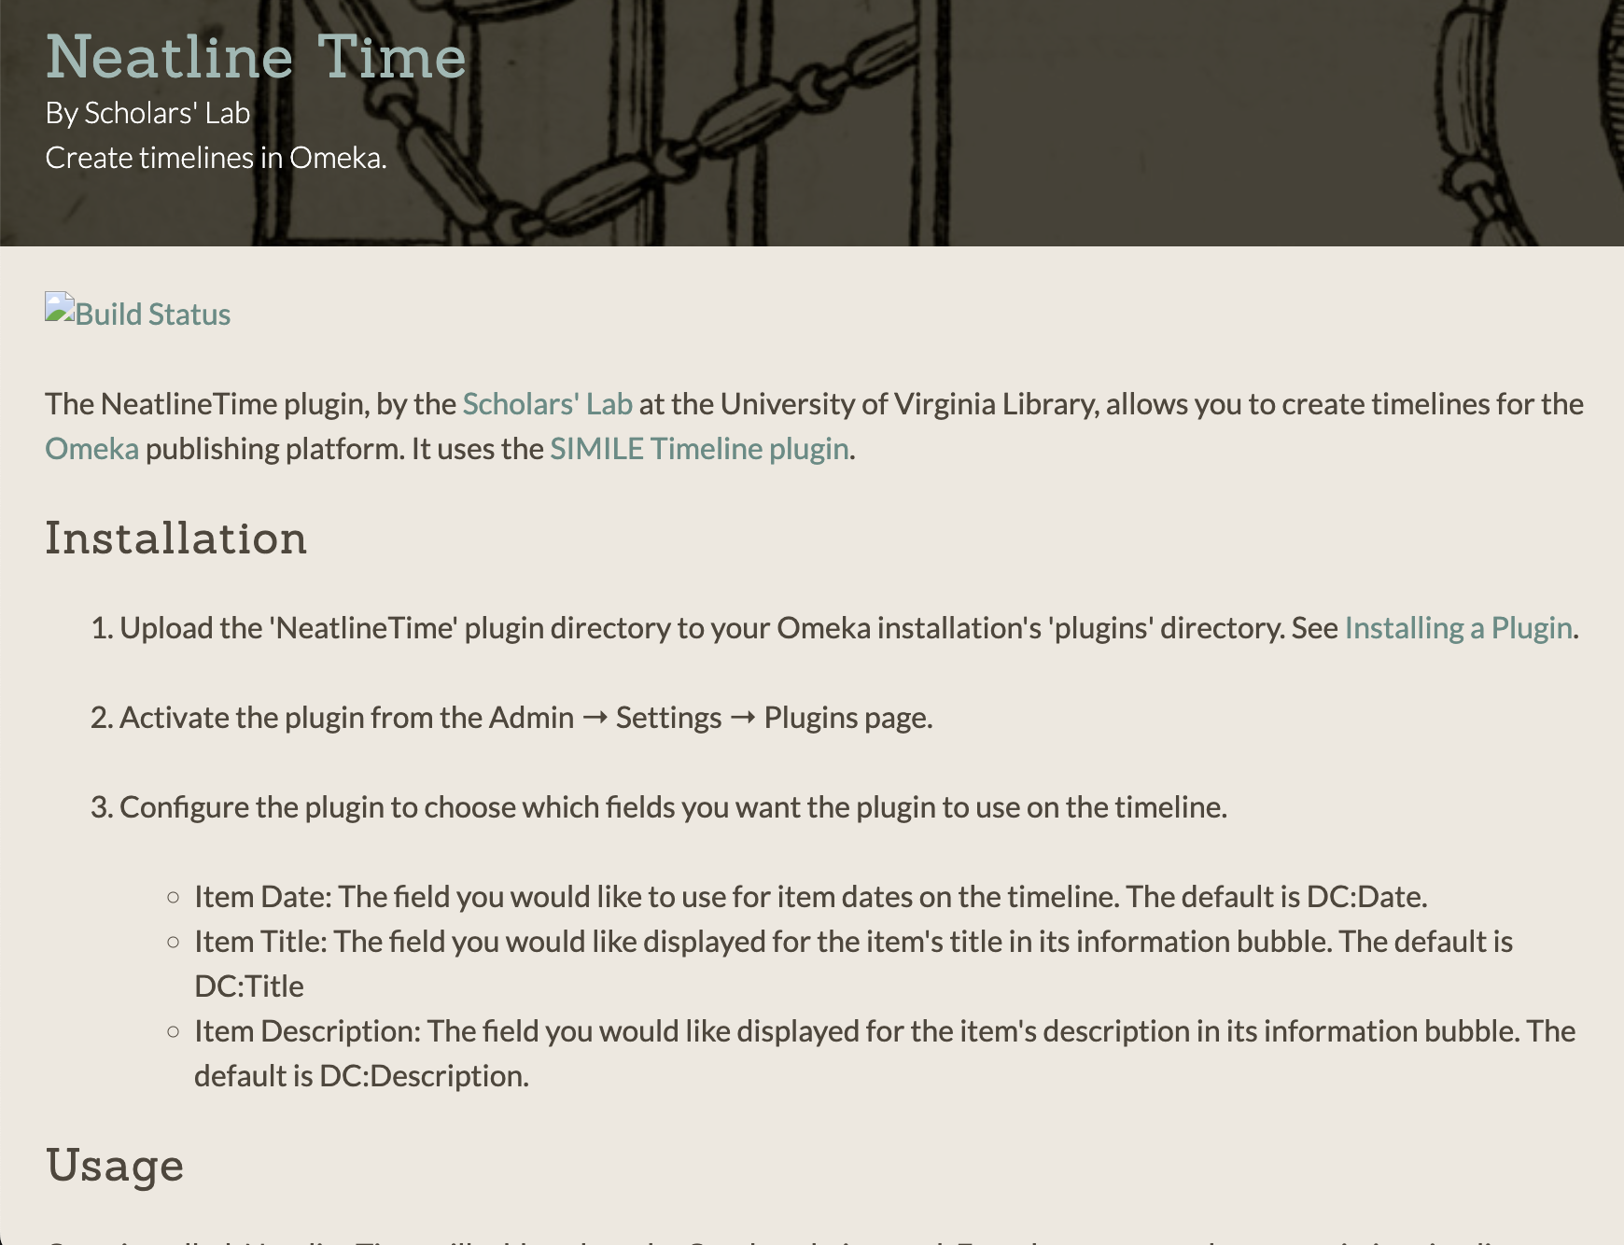
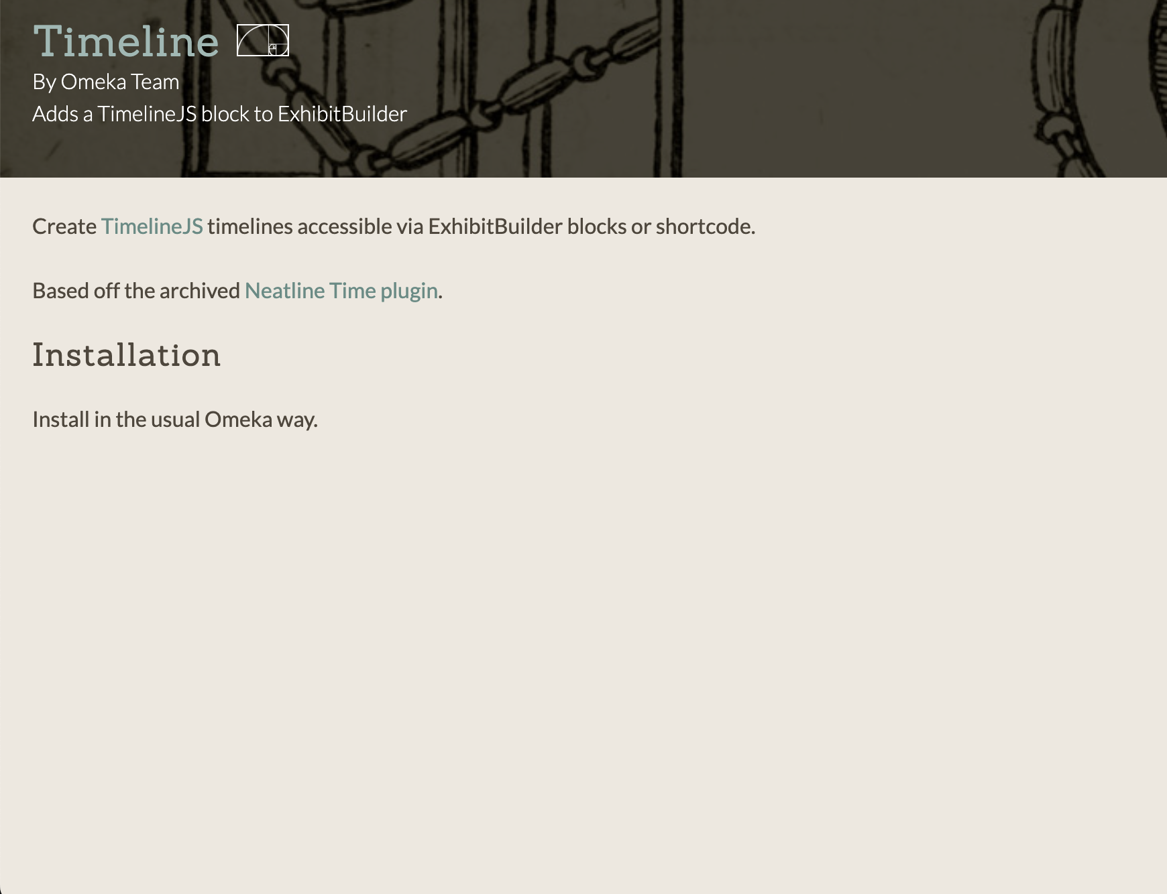
User Story 1.8 Progress
Cady Pridgeon
Neatline Time plugin
Timeline plugin

Slide 19
Design
Amee Kivette
Author_Last_Name_First_Name
Author_First_Name_Last_Name
BirthDate
Death Date
Architecture
Omeka Classic
Reclaim Hosting
Primary Interactions
Author Data → Omeka Classic
Omeka Classic → Reclaim Hosting
Administrators → Author Data
Within Omeka Classic
Author Data → Plugins that facilitate data visualization
CSV Data Fields
Author_Biography
Source
Book_Publications

Slide 20




Process
Amee Kivette
Content Management System
Omeka Classic
Source Code Management
Reclaim Hosting
Team Communication
Text message for general purposes
Zoom for meetings
Email for sponsor communications
User Story, Task, & Issue Management
Assignments split between members
Tasks created on a Kanban board in Notion
Problems are discussed with the team

Slide 21
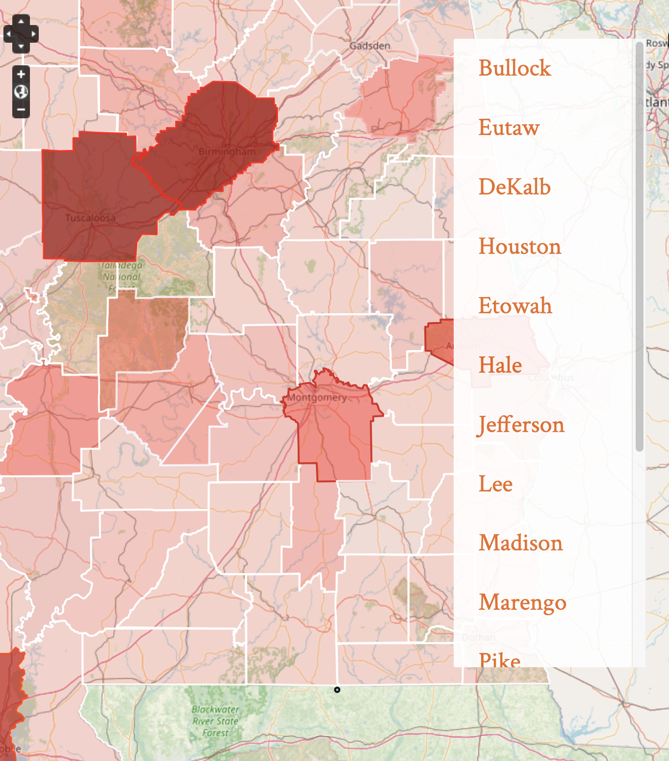
Lessons Learned
Laura Wilson
Regular communication, thorough documentation, and clear sponsor expectations are important
Utilizing a content management system can be beneficial for users but is limiting for developers
Decreased visualization flexibility
Outdated features
Alabama Authors literary map

Slide 22
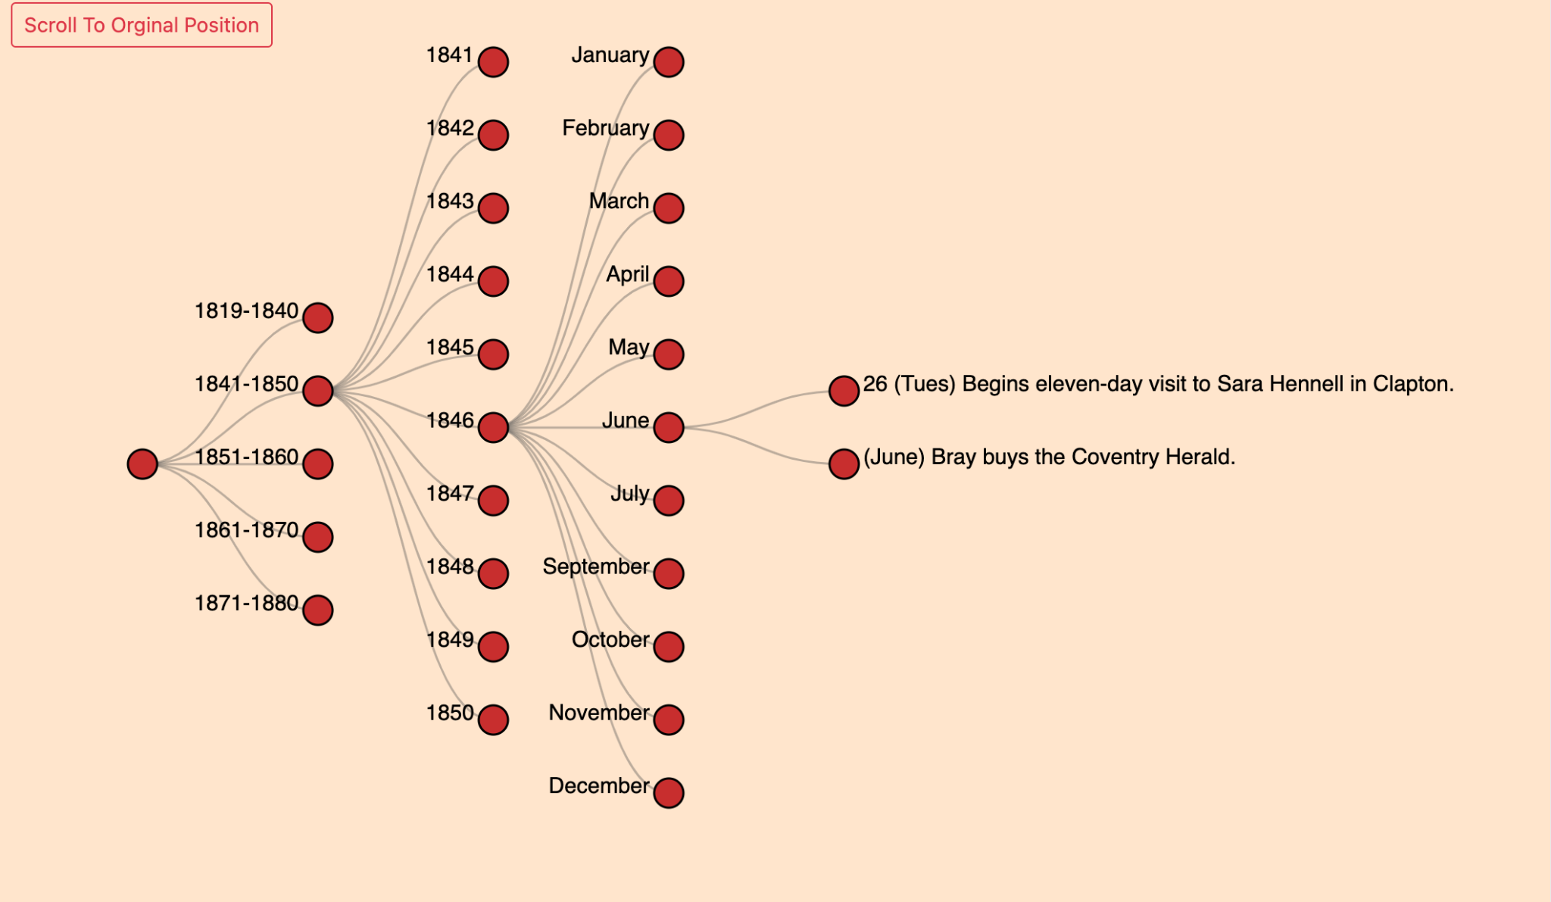
Current Plans
Keanna Tennyson
Continue working on user stories in progress
Clean data for duplicates
Discuss data collection with sponsors
Experiment with plugins to determine the best option
Add plugin to Omeka Classic
George Eliot chronology

Slide 23
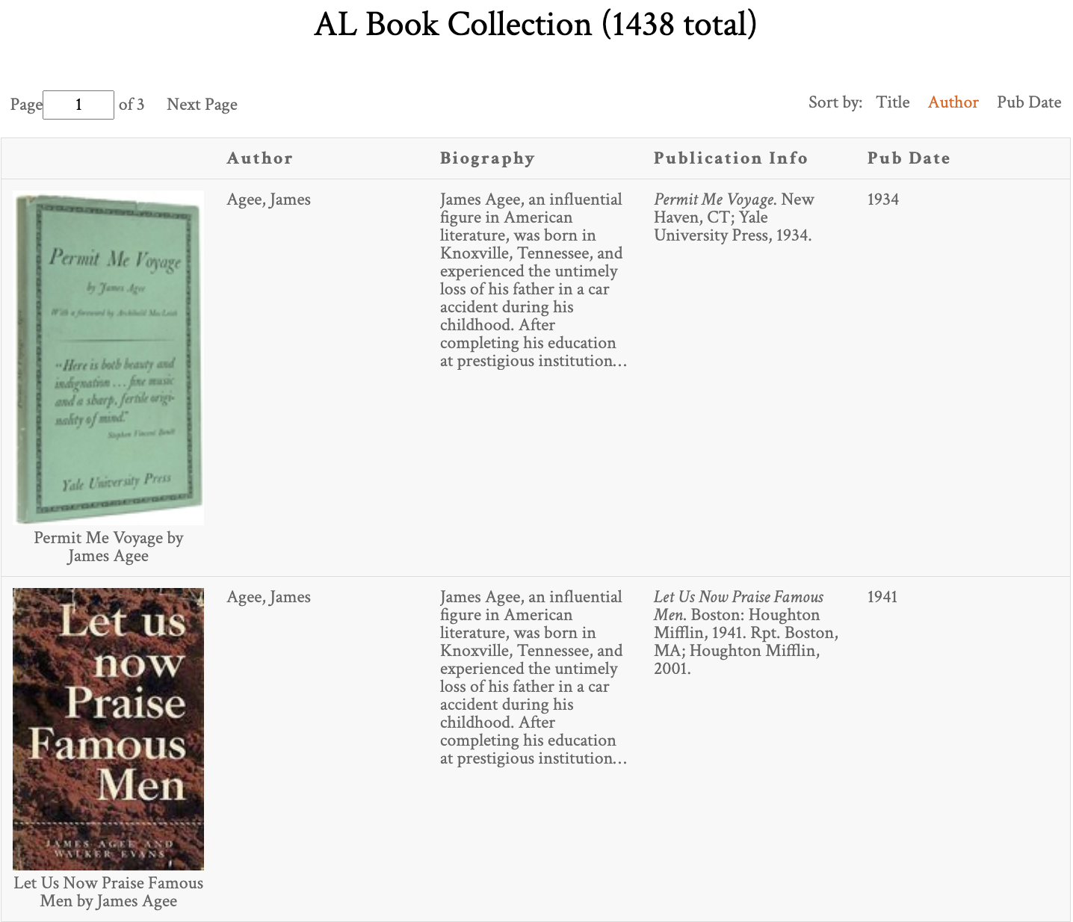
Future Plans
Keanna Tennyson
Explore additional data visualizations for the website
Improve the database
Expand data to other areas of the site
Consider responsive interface design for chronology visualization
Add utility features to chronology
Export, share, etc.
Alabama Authors book collection list

Slide 24
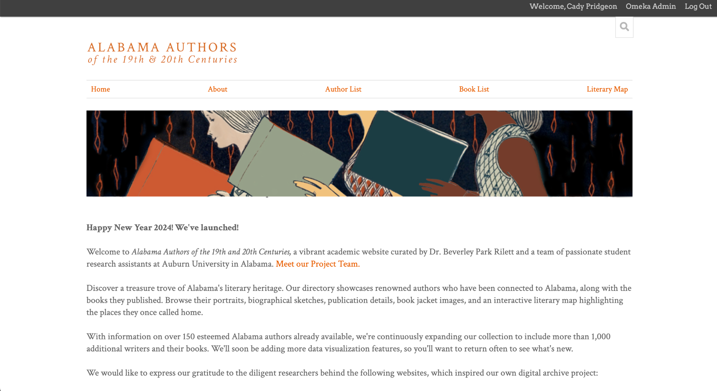
Thank you!
Ask any questions you may have!

